Slide 1
New Adventures in C++ with Cinder and More
And a small pitch for VS 2013 ☺
oct 2013 | nwcpp.org
ale contenti | visual c++ dev mgr
Notes:
Introduce yourself

Slide 2
Agenda
Visual C++ principles
Upcoming Visual Studio 2013 features
Experimenting with Graphics
Visual Studio productivity features
Cinder
Extension SDKs
Box2D
PDB Projects
Anything you need to know/ask/rant/rave about VC++ and VS ☺
Resources

Slide 3
Visual C++ principles
Microsoft ecosystem
Easy to leverage and integrate the value of the different MS platforms
core C++ values
Performance
Standard conformance
Cross platform
Pay for play
Stability
Open C++ community
Down to the metal
productivity
Visual Studio integration
Libraries discovery, acquisition, deployment
Immersive code production experience
Code understanding
Code debugging
innovation
Leading and collaborating with the industry
Notes:
C++ (core C++ values), Productivity, Innovation, Microsoft stack

Slide 4
Visual Studio 2013 – What’s New
Performance
Std Conformance
Cross platform
Productivity
Microsoft ecosystem
Notes:
Likely 2 or 3 slides

Slide 5
Visual Studio 2013 - Performance
Performance
Better auto-vectorization
Vector calling convention
C++ AMP: shared memory support, enhanced texture support, debugging support on Win7
Graphics debugging: support in VS Express, remote capture, compute shader debugging, faster frame capture and caching
Notes:
Likely 2 or 3 slides

Slide 6
Visual Studio 2013 – Std Conformance
Explicit conversion operators
Non-static data member initializers
Raw string literals
= default
Function template default arguments
= delete
Delegating constructors
“using” aliases
C++14 libs: type aliases
Uniform init & initializer_lists
Variadic templates
C++14 libs: cbegin/ greater<>/make_unique
C99 compound literals
C99 variable decls
C99 _Bool
C99 designated initializers

Slide 7
Visual Studio 2013 – Cross platform
C++ REST SDK
Cloud-based client-server communications library for C++
Connecting and interacting with RESTful services
Uncompromised performance and productivity
Asynchrony for responsiveness and scalability
Uses modern C++11 patterns
Cross-platform enabled and OSS

Slide 8
Visual Studio 2013 – Productivity
Code formatting
Header/code switching
Code peek
Code Analysis UI enhancements
NuGet for C++
Async debugging
Just-my-code debugging
Better interop debugging (JavaScript/C++, C#/VB/C++, CPython/C++, GPU/CPU)

Slide 9
Visual Studio 2013 – Microsoft ecosystem
Support for Windows 8.1 Store Apps
Live tiles, push notifications, new WinMD constructs
Better XAML Designer
Deeper diagnostics: XAML UI responsiveness profiling, Energy profiler, CPU profiling

Slide 10
New Adventures in C++
200,00 files in the same project
The boundary, or fringe
All the C++ code in the world
Graphic advertisement with 100 surfaces attached together with 3 kinects
Mega map/reduce on heterogeneus clusters with GPU and vector-units
Just 1 file
Notes:
for the advertisement campaign for the next soccer worl cup

Slide 11
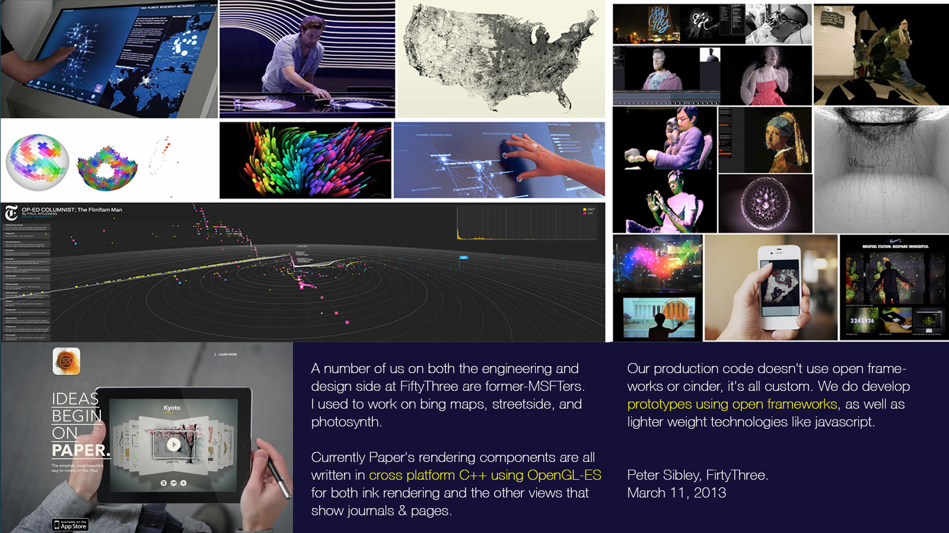
Creating magic

Slide 12
Experiment with Graphics
Creativity
Molding
Art
Experiment, prototype
Fun, delight
Throw ideas on the screen
See them in motion
Easy to access, low barrier
Intuitive to do simple things
Modern C++
Don’t limit me
Community
Composable

Slide 13
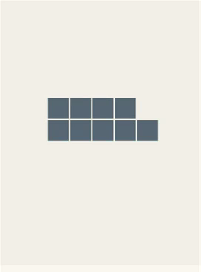

Creating magic with Cinder
Notes:
WordShift: http://www.youtube.com/watch?v=RYOjXFIRNzo
Planetary: http://www.youtube.com/watch?v=xF34ERDdrjk

Slide 14
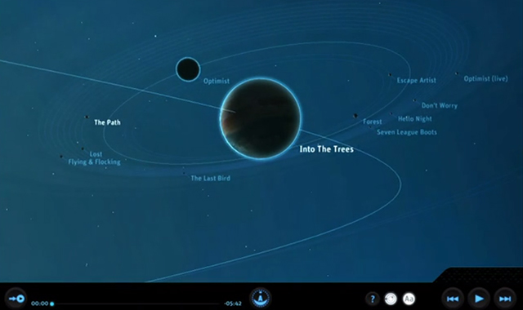
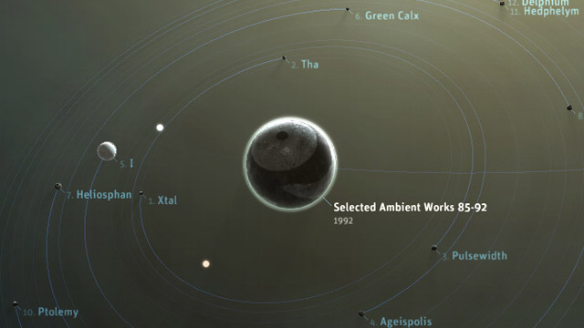
Nobody knows what “most” C++ programmers do
Did you know?
C++ library openFrameworks is widely used in teaching art & design
Incl. prestigious schools like Parsons School for Design
C++ “creative coding” library Cinder awarded ad industry’s highest honor
June 2013: Cannes Lions Festival, Innovation Grand Prix
C++ app Planetary acquired by Smithsonian
August 2013: The museum’s first-ever curation/preservation of code

Slide 15
Let’s dive in
Acquisition Playing with Cinder and Box2d Leveraging VS 2013 to make it easy to understand the code and experiment Disclaimer! I’m no DX expert, nor Cinder expert! ☺ Just a dude exploring the fringe to understand more!
Notes:
We’ll jump around a little! Bear with me…

Slide 16
What did we see
Grab Cinder for Windows Store from github
Compile and look at one sample
Simplified the code and made it reusable
Created a new project, added pen support
Looked into Box2D sample
Hooked up Box2D and Cinder via a simple sandbox lib (from the Cinder community)
Github integration in VS
Assets preview, class view in solution explorer, Peek Definition
Extension SDKs, project templates
PDB-based project
Inspired? Go write some cool demo! ☺ And experiment!

Slide 17
What’s Your Adventure in C++?
?
The boundary, or fringe
All the C++ code in the world
Notes:
for the advertisement campaign for the next soccer worl cup

Slide 18

Questions?
Anything you need to know/ask/rant/rave about VC++ and VS ☺

Slide 19
Resources
Visual C++ blog: http://blogs.msdn.com/vcblog
MSDN: http://msdn.microsoft.com/en-us/visualc/default.aspx
GoingNative: http://channel9.msdn.com/Shows/C9-GoingNative
Cinder on Windows Store: http://channel9.msdn.com/coding4fun/articles/Getting-started-with-Cinder-for-Windows-Store-Apps
PDB project: http://visualstudiogallery.msdn.microsoft.com/952cac4e-fe4d-40a8-9656-9ae863bedbff
Write to alecont and eric:
Ale Contenti alecont@microsoft.com
Eric Battalio ebattali@microsoft.com

